Slide 1
Raoul Wallenberg Day
January 17
Presented by the Centre for Holocaust Education and Scholarship
1

Slide 2
Who was Raoul Wallenberg?
4

Slide 3
Raoul Wallenberg’s Background
Wallenberg is born in Stockholm, Sweden, on August 4, 1912.
As an adult, he lives in Paris and studies architecture the USA.
In 1936, he moves to British-Mandate Palestine to work in the international trade industry. Here, he meets many Jewish refugees from Nazi Germany and gains a deep understanding of the rising levels of antisemitism in Europe.
World War II is declared in 1939, while the Holocaust is already underway.
5

Slide 4
Watch: The Story of Raoul Wallenberg (At a Glance)
10
Notes:
Video (5:21 mins)

Slide 5
Raoul Wallenberg’s Recruitment
March 1944: Nazi Germany invades Hungary, and
437,000 Jews are deported to Auschwitz.
US War Refugee Board recruits Wallenberg for a special rescue mission to Budapest. He speaks multiple languages, is familiar with the city, and has a deep understanding of the plight of the Jewish refugee.
Wallenberg arrives in Budapest on July 9, 1944, and deportations come to a halt.
11

Slide 6
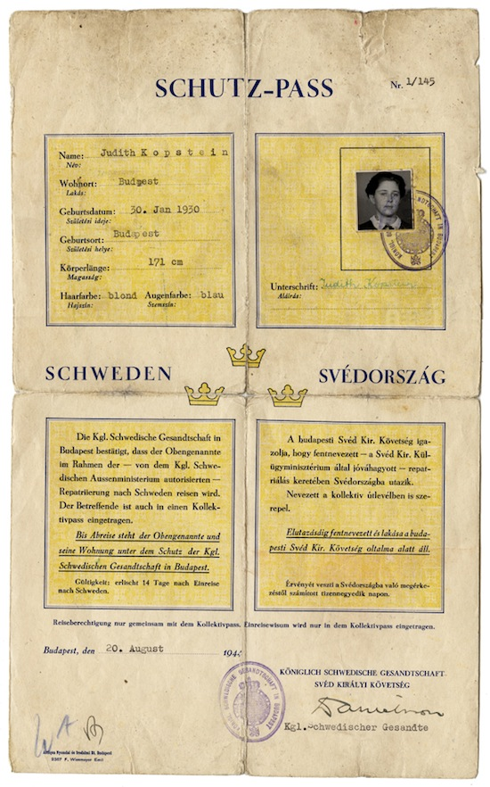
Raoul Wallenberg’s Arrival in Hungary
As a Swedish diplomat, Wallenberg’s task is to help rescue Budapest’s remaining 200,000 Jews.
He is to distribute hundreds of Schutz-Passes, or temporary Swedish protective passes, to Hungarian Jews with ties to Sweden—so that they may escape.
12

Slide 7
Overthrow of the Hungarian Government
On October 15th, the Hungarian government is overthrown by the antisemitic and fascist Arrow Cross Party, an extension of the Nazi party.
Both the pogroms of Jews and their deportations to killing centres resume.
Hungarian Jews being deported in cattle cars to killing centre Auschwitz
13

Slide 8
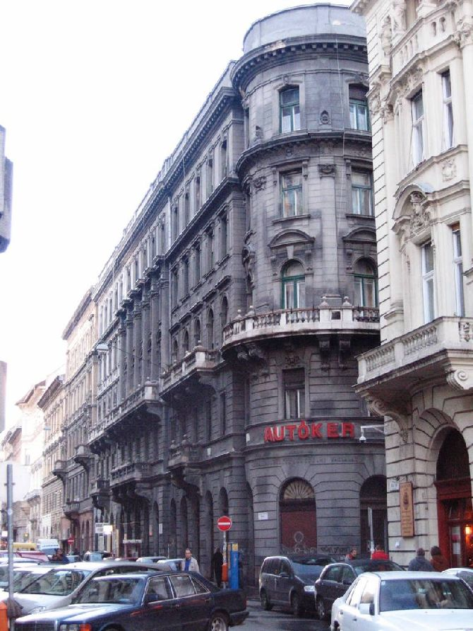
Fighting Deportations
Wallenberg establishes numerous safe houses throughout Budapest. He thus provides 15,000 Jews with food, health care, and other basic needs.
Meanwhile, he distributes thousands of Schutz-Passes, helping thousands of refugees to escape.
A former Wallenberg safe house in Budapest
14

Slide 9
Wallenberg’s Disappearance
On January 17, 1945, the Soviet Forces’ Red Army detains Wallenberg on unfounded suspicions of espionage.
Wallenberg’s whereabouts become unknown thereafter.
It is not until 1956 that the Soviet Union admits to Wallenberg’s imprisonment, confirming not only his captivity, but his death in captivity. His death certificate is not handed over, nor is his place of burial shared with his family.
17

Slide 10
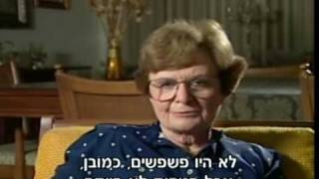
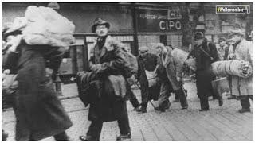
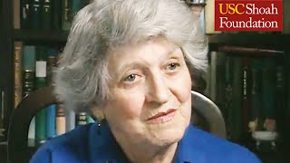
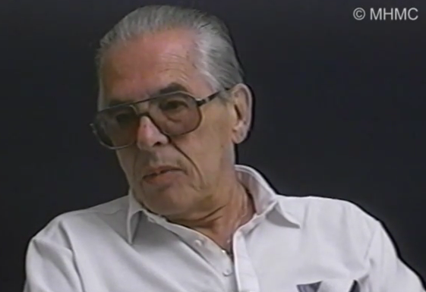
Wallenberg’s Impact: Testimony of Survivors
Wallenberg’s efforts are recognized as having saved the lives of 100,000 Jews.
Vera Goodkin’s Testimony
(4 min)
Summary of Testimonies (2 min)
Tommy Strasser’s Testimony
(3 mins)
Agnes Adachi’s Testimony (7 min)
18
Notes:
Canadian’ perspective - “Tommy Strasser”

Slide 11
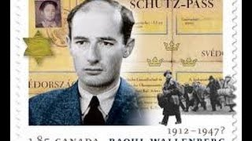
Watch: “If you save one life, you save the whole world”
Righteous Among the Nations
For his incredible bravery and sense of morality, on November 26, 1963, Wallenberg is recognized by Yad Vashem as Righteous Among the Nations, an honorific granted by the Supreme Court of the State of Israel to all the non-Jews who, out of pure altruism, risked their own lives to help protect Europe’s Jews from the Nazis.
Hebrew inscription on medal: “Whoever saves one life saves the world entire.”
19

Slide 12
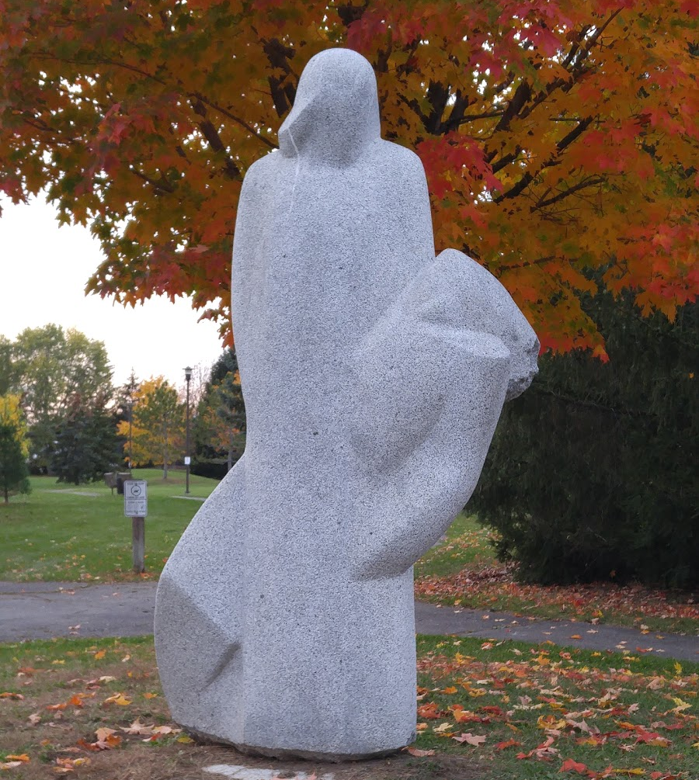
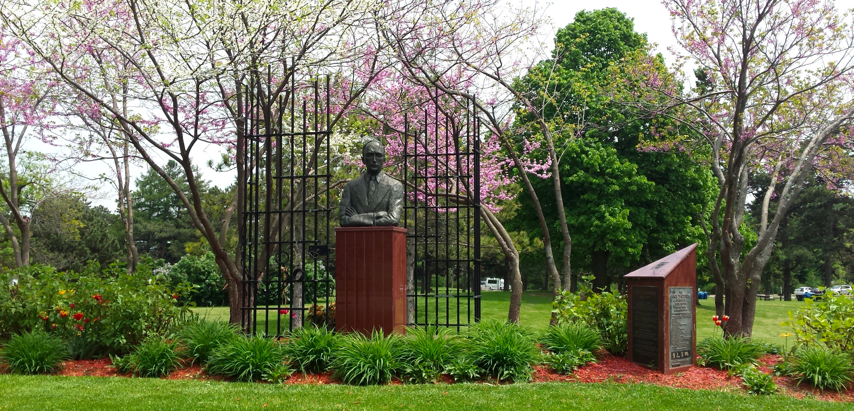
Homage to Wallenberg
Countless countries around the globe have created monuments in Wallenberg’s honour. He is an honorary citizen of the United Kingdom, the United States, Hungary, Canada, and Israel.
Top: The Raoul Wallenberg Memorial, Toronto, Canada. Margin, entire: Raoul Wallenberg Park, Nepean (Ottawa), Canada. Margin, top: Park sign commemorating Wallenberg. Margin, middle: “Pietà” Statue (1987) at the park, created by sculptor Uga Drava, in honour of Wallenberg. Margin, bottom: Plaque by the City of Nepean at the park featuring the Talmudic phrase “He who saves a life is as if he saved an entire world.” The plaque states that Wallenberg’s humanitarian actions in WWII saved 100,000 Jews.
20

Slide 13
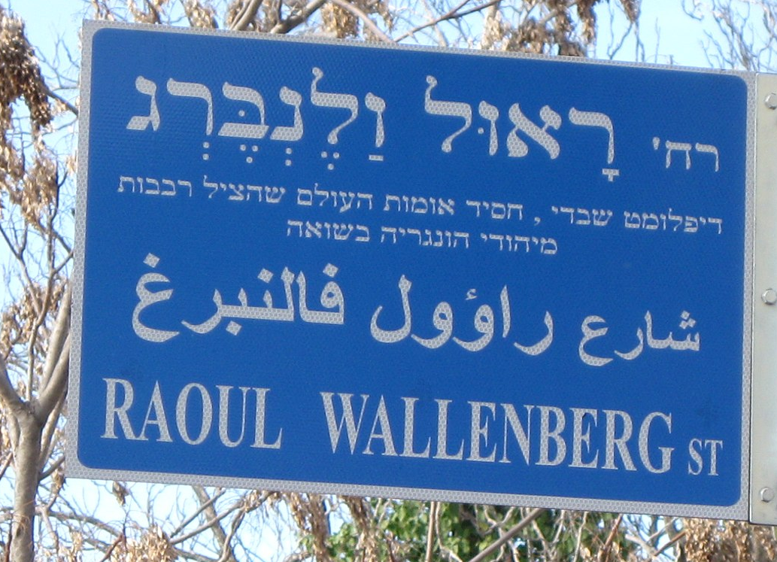
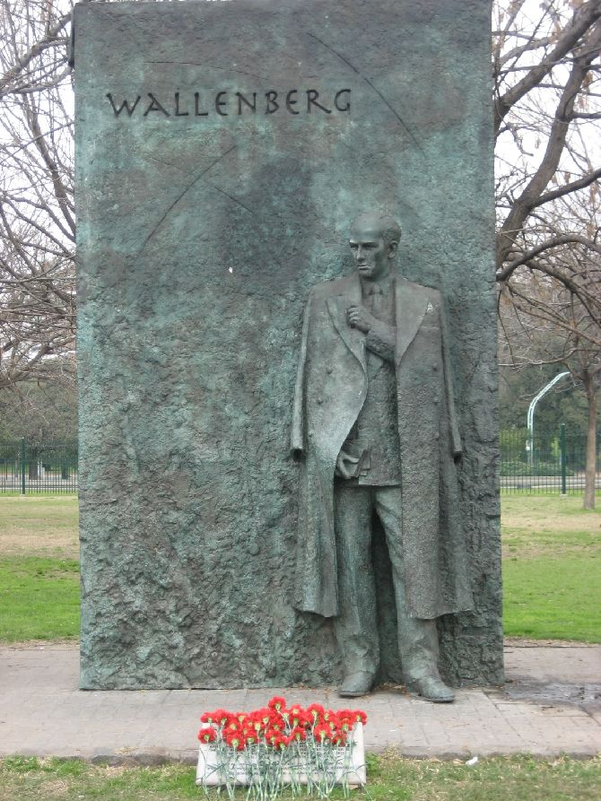
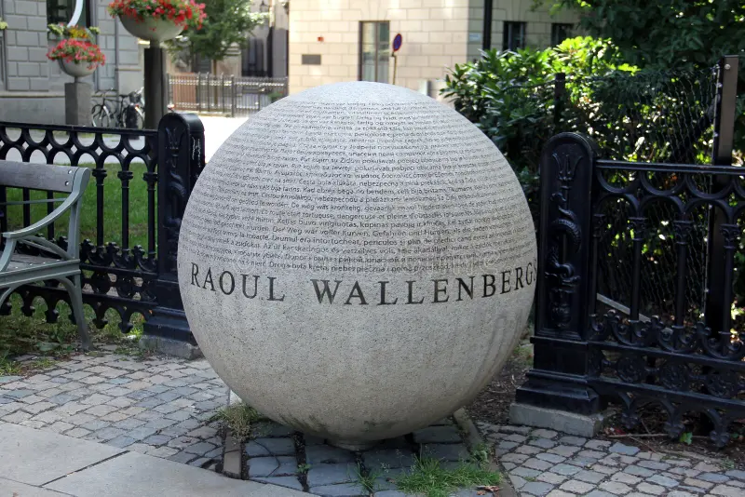
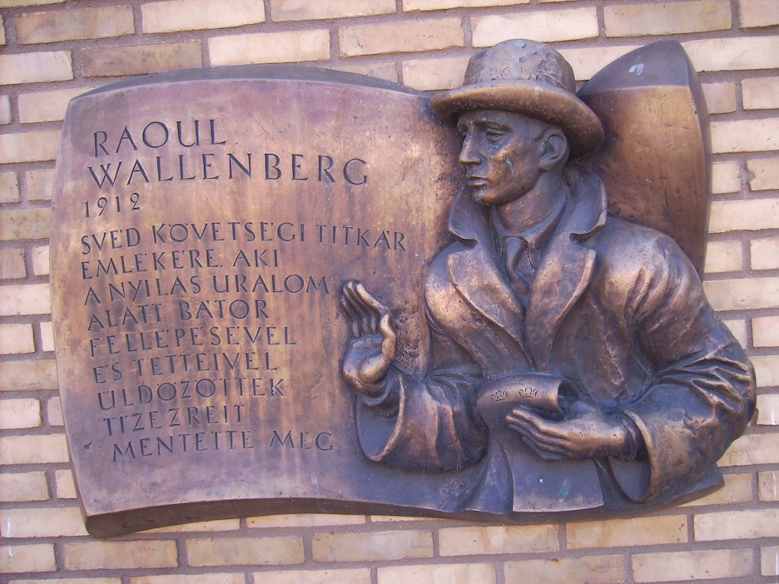
Homage to Wallenberg
Street in Jerusalem, Israel
Monument in Stockholm, Sweden
Monument in London, UK
Monument in Buenos Aires, Argentina
21
Monument in Linköping, Sweden

Slide 14
Honorary Citizenship of Canada
The Raoul Wallenberg Room
“And whereas Raoul Wallenberg, with extraordinary courage and with total disregard for the constant danger to himself, saved the lives of almost one hundred thousand innocent Jewish men, women, and children, a considerable number of whom now live in Canada… Now therefore the Senate and House of Commons solve that the said Raoul Wallenberg is hereby declared to be an honorary citizen of Canada.”
Parliament of Canada, 1985
Canada’s First Honorary Citizen
22

Slide 15
Raoul Wallenberg Day 2023: Prime Minister Justin Trudeau’s Statement
“Today, we pay tribute to Raoul Wallenberg, a remarkable hero and humanitarian who put his life on the line to save Jews in German-occupied Hungary from persecution, deportation to concentration camps, and death during the Holocaust.
“Mr. Wallenberg has been called ‘the greatest humanitarian of the 20th century’ by the United Nations and was named Canada’s first honorary citizen in 1985. A Swedish diplomat and businessman, he saved the lives of tens of thousands of Hungarian Jews in just six months, between July 1944 and January 1945, through the granting of diplomatic passes giving them immunity. He also established a network of safe havens operating under Swedish diplomatic immunity to shelter and protect those fleeing persecution from the Nazi regime. Tragically, he disappeared in 1945 after being arrested by the Soviets and sent to forced labour camps. In 2001, the Government of Canada designated January 17th, the date of his disappearance, as Raoul Wallenberg Day.
“Mr. Wallenberg’s legacy is celebrated worldwide and is a powerful reminder of the difference one person can make when they choose to confront evil and take action. His selflessness and courage are reflected in his own famous words: ‘To me, there is no other choice.’
25

Slide 16
Raoul Wallenberg Day 2023: Prime Minister Justin Trudeau’s Statement
“As a country, Canada has been profoundly shaped by the many contributions of some 40,000 Holocaust survivors who resettled here after the war. Today, and every day, Canadians remember the Holocaust, honour its victims, and commemorate the survivors.
“Today, with a disturbing rise in antisemitism at home and around the world, we must maintain our collective commitment to standing up against all forms of hate and discrimination. Each of us, Jews and non-Jews alike, have an ongoing responsibility to speak up in the face of antisemitism whenever and wherever it occurs. All Canadians have a continued role to play in making sure that fundamental respect and inclusion is at the heart of our strong communities.
“On Raoul Wallenberg Day, I encourage all Canadians to reflect on Mr. Wallenberg’s remarkable story and to draw inspiration from his heroism, his humanitarianism, and his dedication to justice. The Government of Canada will always stand up against antisemitism as we build a more equal, safe, and just world for everyone.”
What is the significance of Raoul Wallenberg Day to Canada?
26

Slide 17
Wallenberg’s Determination
“I could never return to Sweden without knowing inside myself that I’d done all a man could do to save as many Jews as possible.”
Raoul Wallenberg in a letter to his friend Per Anger
Left: Raoul Wallenberg as an adult. Right: The US Raoul Wallenberg Bronze Medal, US Mint.
24

