Slide 1
Raoul Wallenberg Day
January 17
Presented by the Centre for Holocaust Education and Scholarship
1

Slide 2
MINDS ON: Pre-Lesson Vocabulary
Altruism:
Antisemitism:
Diplomacy:
Genocide:
Ghettos:
Honorary Citizenship:
Legacy:
Persecution:
Pogrom:
2

Slide 3
MINDS ON: Pre-Lesson Vocabulary
Altruism: The condition of acting in a way that benefits others even at one’s own expense
Antisemitism: Hostility towards, prejudice against, or violence targeted at Jewish people
Diplomacy: The field or process of establishing and maintaining cordial country-to-country relations
Genocide: The deliberate killing of a racial, ethnic, or religious group with the intent to destroy it
Ghettos: Segregated enclosements where Jews were forced to live during Europe’s Nazi Regime
Honorary Citizenship: A symbolic status bestowed by a government to a particularly admirable person
Legacy: The long-lasting impact that a significant person or event has on society or a group of people
Persecution: Cruelty towards a group on the basis of religion, ethnicity, race, or sexual orientation
Pogrom: The organized massacre of a persecuted group, particularly of Jews in Eastern Europe during the 19th and 20th centuries
3

Slide 4
Who was Raoul Wallenberg?
4

Slide 5
Raoul Wallenberg’s Background
Wallenberg is born in Stockholm, Sweden, on August 4, 1912.
As an adult, he lives in Paris and studies architecture the USA.
In 1936, he moves to British-Mandate Palestine to work in the international trade industry. Here, he meets many Jewish refugees from Nazi Germany and gains a deep understanding of the rising levels of antisemitism in Europe.
World War II is declared in 1939, while the Holocaust is already underway.
5

Slide 6
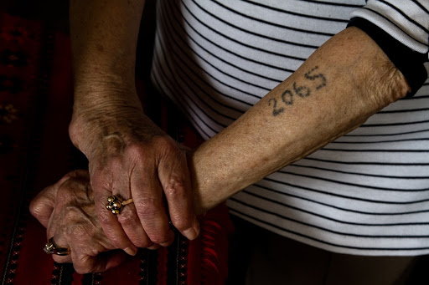
The Holocaust
The largest-scale genocide in human history, the Holocaust refers to the systematic and deliberate murder of Europe’s Jews and other persecuted groups by Adolf Hitler’s Nazi Party with the intent of exterminating these peoples.
Nazi Procession
Inmates at Mauthausen Concentration Camp
Lotte Weiss’s tattoo of her Auschwitz Prisoner Number
6

Slide 7
Watch: The Story of Raoul Wallenberg (At a Glance)
10

Slide 8
Raoul Wallenberg’s Recruitment
March 1944: Nazi Germany invades Hungary, and
437,000 Jews are deported to Auschwitz.
US War Refugee Board recruits Wallenberg for a special rescue mission to Budapest. He speaks multiple languages, is familiar with the city, and has a deep understanding of the plight of the Jewish refugee.
Wallenberg arrives in Budapest on July 9, 1944, and deportations come to a halt.
11

Slide 9
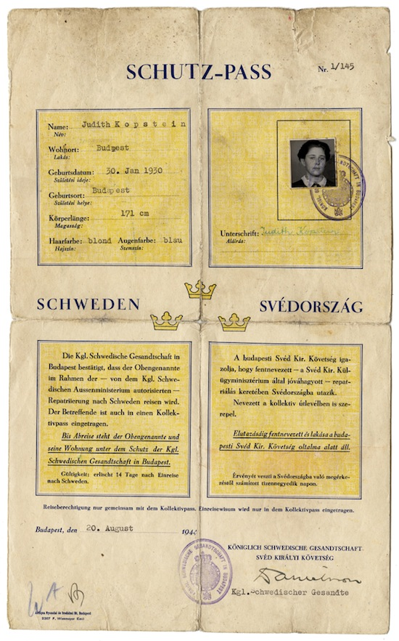
Raoul Wallenberg’s Arrival in Hungary
As a Swedish diplomat, Wallenberg’s task is to help rescue Budapest’s remaining 200,000 Jews.
He is to distribute hundreds of Schutz-Passes, or temporary Swedish protective passes, to Hungarian Jews with ties to Sweden—so that they may escape.
12

Slide 10
Overthrow of the Hungarian Government
On October 15th, the Hungarian government is overthrown by the antisemitic and fascist Arrow Cross Party, an extension of the Nazi party.
Both the pogroms of Jews and their deportations to killing centres resume.
Hungarian Jews being deported in cattle cars to killing centre Auschwitz
13

Slide 11
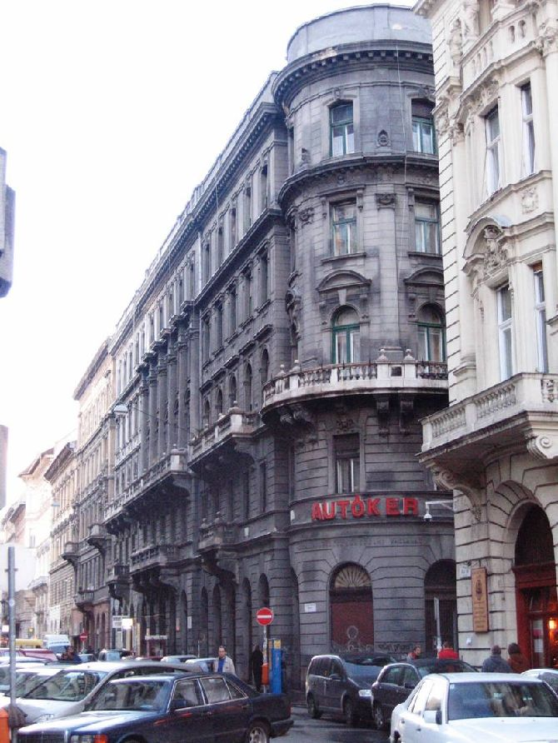
Fighting Deportations
Wallenberg establishes numerous safe houses throughout Budapest. He thus provides 15,000 Jews with food, health care, and other basic needs.
Meanwhile, he distributes thousands of Schutz-Passes, helping thousands of refugees to escape.
A former Wallenberg safe house in Budapest
14

Slide 12
Death Marches
November 6th, 1944: Nazi Official Adolf Eichmann orders a Death March to Austria, to send Jews “on loan” as slave labourers.
Prisoners are forced to walk. The march lasts one month. Many die along the way. Those who survive are sent to the Camps.
Eichman’s Death March of Hungarian Jews, November 1944
15

Slide 13
Fighting Death Marches
Wallenberg personally chases down the groups of detainees on the Death Marches, handing out protective passes to as many as possible, thus granting these individuals the right to enter Sweden.
Wallenberg (right, hands clasped) distributing Swedish passes to Hungarian Jews at Budapest train station
16

Slide 14
Wallenberg’s Disappearance
On January 17, 1945, the Soviet Forces’ Red Army detains Wallenberg on unfounded suspicions of espionage.
Wallenberg’s whereabouts become unknown thereafter.
It is not until 1956 that the Soviet Union admits to Wallenberg’s imprisonment, confirming not only his captivity, but his death in captivity. His death certificate is not handed over, nor is his place of burial shared with his family.
17

Slide 15
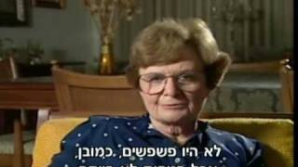
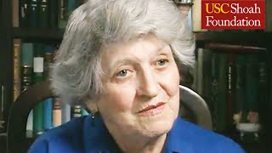
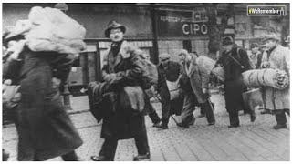
Wallenberg’s Impact: Testimony of Survivors
Wallenberg’s efforts are recognized as having saved the lives of 100,000 Jews.
Vera Goodkin’s Testimony
(4 min)
Agnes Adachi’s Testimony (7 min)
Summary of Testimonies (2 min)
18

Slide 16
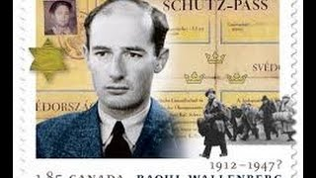
Watch: “If you save one life, you save the whole world”
Righteous Among the Nations
For his incredible bravery and sense of morality, on November 26, 1963, Wallenberg is recognized by Yad Vashem as Righteous Among the Nations, an honorific granted by the Supreme Court of the State of Israel to all the non-Jews who, out of pure altruism, risked their own lives to help protect Europe’s Jews from the Nazis.
Hebrew inscription on medal: “Whoever saves one life saves the world entire.”
19

Slide 17
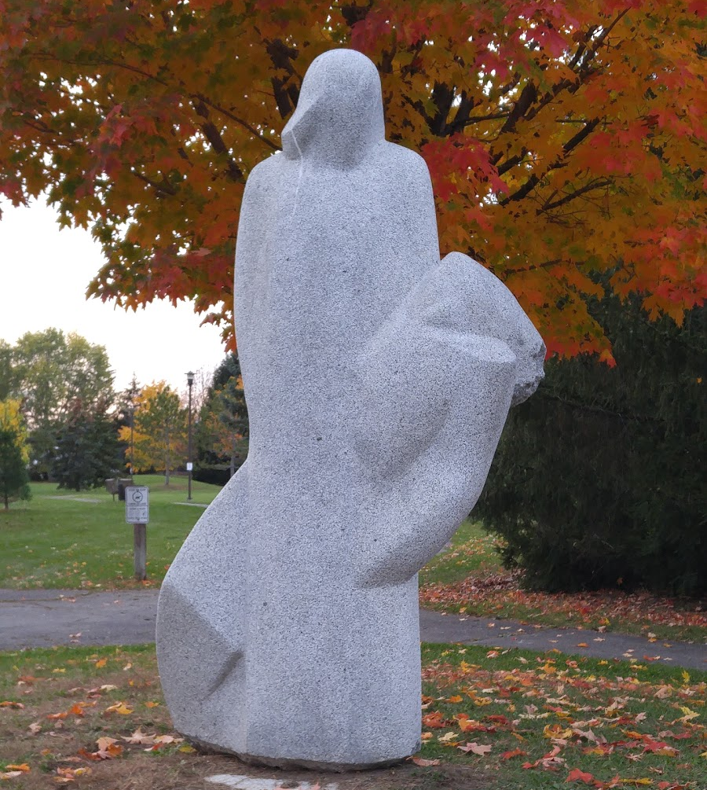
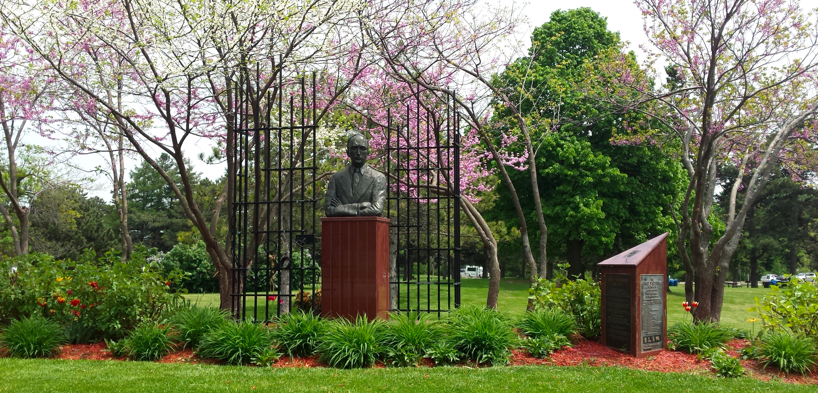
Homage to Wallenberg
Countless countries around the globe have created monuments in Wallenberg’s honour. He is an honorary citizen of the United Kingdom, the United States, Hungary, Canada, and Israel.
Top: The Raoul Wallenberg Memorial, Toronto, Canada. Margin, entire: Raoul Wallenberg Park, Nepean (Ottawa), Canada. Margin, top: Park sign commemorating Wallenberg. Margin, middle: “Pietà” Statue (1987) at the park, created by sculptor Uga Drava, in honour of Wallenberg. Margin, bottom: Plaque by the City of Nepean at the park featuring the Talmudic phrase “He who saves a life is as if he saved an entire world.” The plaque states that Wallenberg’s humanitarian actions in WWII saved 100,000 Jews.
20

Slide 18
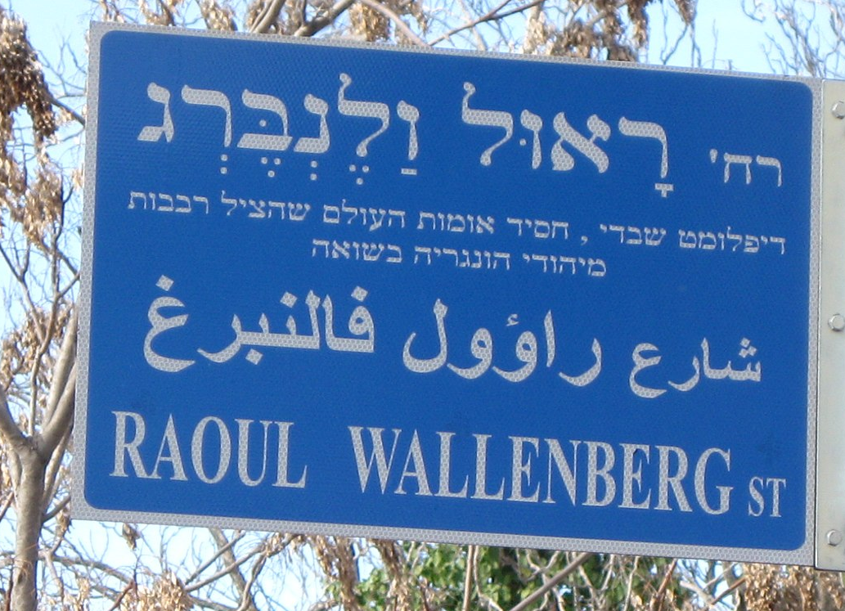
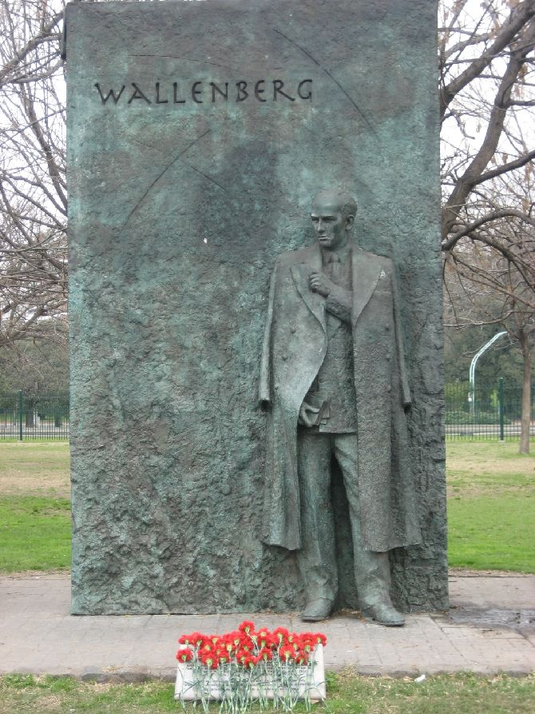
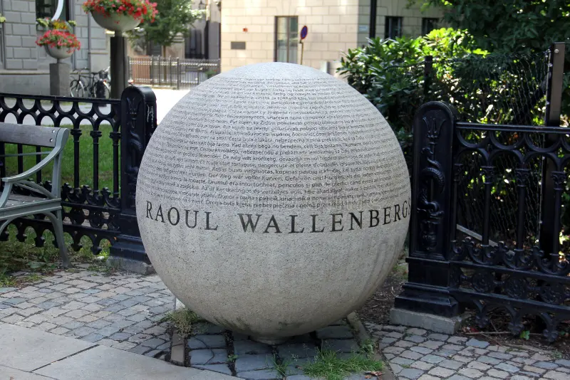
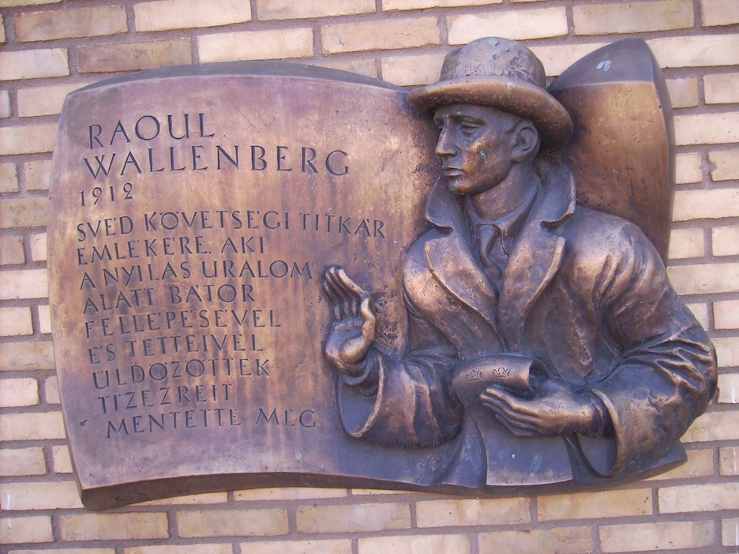
Homage to Wallenberg
Street in Jerusalem, Israel
Monument in Stockholm, Sweden
Monument in London, UK
Monument in Buenos Aires, Argentina
21
Monument in Linköping, Sweden

Slide 19
Honorary Citizenship of Canada
The Raoul Wallenberg Room
“And whereas Raoul Wallenberg, with extraordinary courage and with total disregard for the constant danger to himself, saved the lives of almost one hundred thousand innocent Jewish men, women, and children, a considerable number of whom now live in Canada… Now therefore the Senate and House of Commons solve that the said Raoul Wallenberg is hereby declared to be an honorary citizen of Canada.”
Parliament of Canada, 1985
Canada’s First Honorary Citizen
22

Slide 20
Wallenberg’s Determination
“I could never return to Sweden without knowing inside myself that I’d done all a man could do to save as many Jews as possible.”
Raoul Wallenberg in a letter to his friend Per Anger
Left: Raoul Wallenberg as an adult. Right: The US Raoul Wallenberg Bronze Medal, US Mint.
24

Slide 21
Raoul Wallenberg Day 2023: Prime Minister Justin Trudeau’s Statement
“Today, we pay tribute to Raoul Wallenberg, a remarkable hero and humanitarian who put his life on the line to save Jews in German-occupied Hungary from persecution, deportation to concentration camps, and death during the Holocaust.
“Mr. Wallenberg has been called ‘the greatest humanitarian of the 20th century’ by the United Nations and was named Canada’s first honorary citizen in 1985. A Swedish diplomat and businessman, he saved the lives of tens of thousands of Hungarian Jews in just six months, between July 1944 and January 1945, through the granting of diplomatic passes giving them immunity. He also established a network of safe havens operating under Swedish diplomatic immunity to shelter and protect those fleeing persecution from the Nazi regime. Tragically, he disappeared in 1945 after being arrested by the Soviets and sent to forced labour camps. In 2001, the Government of Canada designated January 17th, the date of his disappearance, as Raoul Wallenberg Day.
“Mr. Wallenberg’s legacy is celebrated worldwide and is a powerful reminder of the difference one person can make when they choose to confront evil and take action. His selflessness and courage are reflected in his own famous words: ‘To me, there is no other choice.’
25

Slide 22
Raoul Wallenberg Day 2023: Prime Minister Justin Trudeau’s Statement
“As a country, Canada has been profoundly shaped by the many contributions of some 40,000 Holocaust survivors who resettled here after the war. Today, and every day, Canadians remember the Holocaust, honour its victims, and commemorate the survivors.
“Today, with a disturbing rise in antisemitism at home and around the world, we must maintain our collective commitment to standing up against all forms of hate and discrimination. Each of us, Jews and non-Jews alike, have an ongoing responsibility to speak up in the face of antisemitism whenever and wherever it occurs. All Canadians have a continued role to play in making sure that fundamental respect and inclusion is at the heart of our strong communities.
“On Raoul Wallenberg Day, I encourage all Canadians to reflect on Mr. Wallenberg’s remarkable story and to draw inspiration from his heroism, his humanitarianism, and his dedication to justice. The Government of Canada will always stand up against antisemitism as we build a more equal, safe, and just world for everyone.”
26

Slide 23
Extensions: Questions to Ponder
1. Look up information about the Righteous Among the Nations. Who does the list of recipients include? What are some of the characteristics these individuals share? Why do you think their designation as Righteous Among the Nations is fitting? Explain.
2. Why do you think the Righteous Among the Nations Medal showcases the Talmud (Jewish scripture) phrase “Whoever saves one life saves the world entire”? What does this phrase mean to you? What does the phrase mean in the context of those saved by the Righteous Among the Nations? Watch the videos of the testimonies in this presentation. Produce an answer to the questions, incorporating what you learned from the testimonies.
27

Slide 24
Extensions: Questions to Ponder
3. Why do you think it is important to learn about Raoul Wallenberg and other individuals declared Righteous Among the Nations? You may incorporate aspects from the testimonies and from the Government of Canada’s statement on Raoul Wallenberg Day. Extension: Look up the Canadian Charter of Rights and Freedoms and draw parallels between the content of the Charter and the actions and beliefs embodied by those who are Righteous Among the Nations.
4. Holocaust denial and Holocaust distortion are a form of modern-day antisemitism, and a real and troubling issue. In many countries (including Austria, Belgium, the Czech Republic, France, Germany, Israel, Liechtenstein, Lithuania, the Netherlands, Poland, Romania, Slovakia, Spain, and Switzerland) Holocaust denial and distortion are crimes punishable by law. Such actions are not only profoundly disrespectful to Holocaust victims and their families, but to the rescuers—including Wallenberg—who sacrificed their lives to help those persecuted by the Nazis. How can we combat Holocaust denial, downplaying, and distortion in our daily lives? Think of specific actions which you, as a high-school student in Canada, can take to do so.
28

Slide 25
Extensions: Questions to Ponder
5. Learning about the Holocaust involves a high level of not only mental but emotional stamina, as well as the ability to digest information that is, by nature, extremely difficult to digest. This lesson only begins to scratch a sliver of the surface of the vast field that is Holocaust Education. Which parts of this lesson did you find most challenging to absorb, and why? Which parts did you find most interesting, and why? What words were you less familiar with? Do you remember the context in which they were used? Write the words down, define them, and explain what you learned about them.
6. If you could write a letter to Wallenberg and he could read it, what would you say? In what ways did Wallenberg’s story move you? In what ways did it resonate with you? How can we, in our daily lives, act in ways that we think would make Wallenberg proud of our integrity, of our actions? Answer these questions in your letter to explain how you will continue his legacy. Address your letter using an appropriate salutation and letter conventions. Organize your ideas coherently (introduction, body, conclusion) and utilize proper grammar and sentence structure.
29

Slide 26
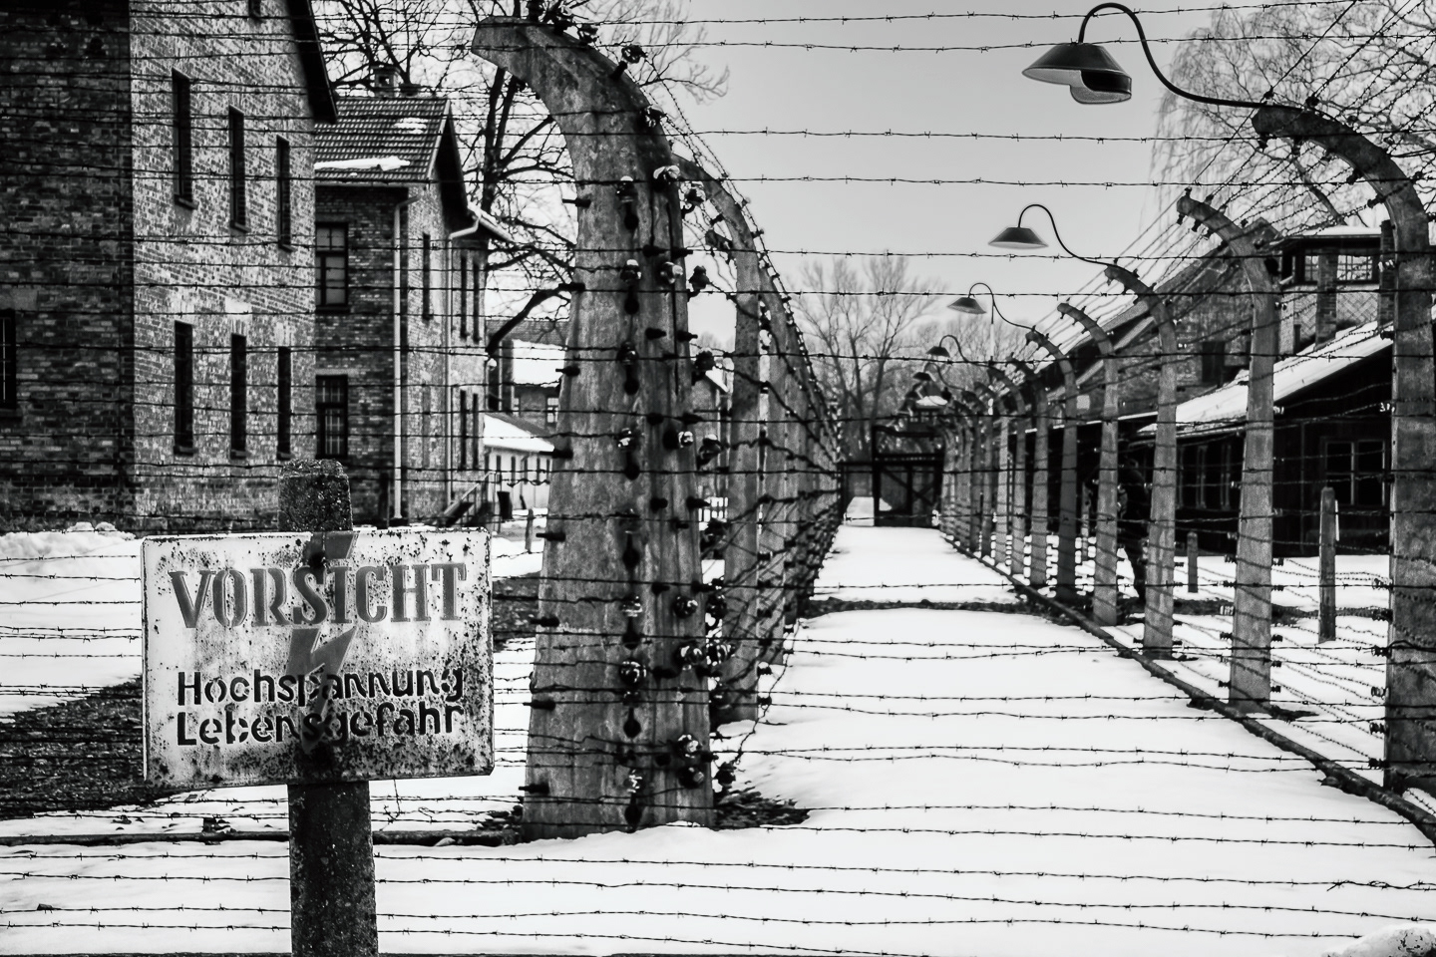
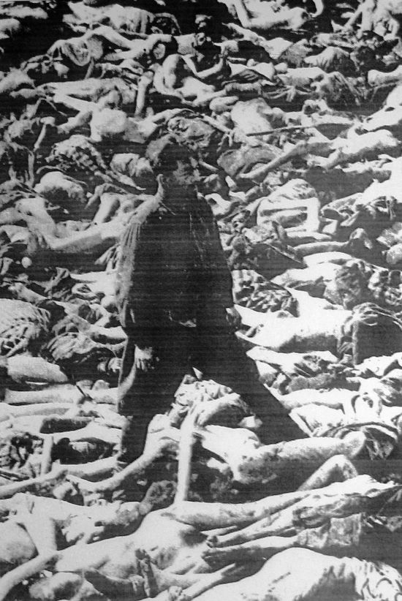
Concentration Camps
1933 to 1945: Amidst soaring antisemitism levels, the Nazis design and build more than 44,000 Concentration Camps, Death Camps, or killing centres to:
- imprison and torture prisoners to death
- strip prisoners of their human dignity
prisoner IDs tattooed, hair shaven, possessions taken, clothes stripped, uniforms given,
extreme forced manual labour
extreme starvation leading to death
separation from family and loved ones
physical enslavement and psychological entrapment
cruel, extreme experimentation (especially on children, pregnant women, and twins) leading to disease and to death
- kill prisoners by way of gas chambers, mass shootings, and crematoria
Top: Auschwitz sign behind barbed wire reads, “Caution: High voltage; Life threatening.” Bottom: Nazi doctor Fritz Klein walks amongst corpses.
7

Slide 27
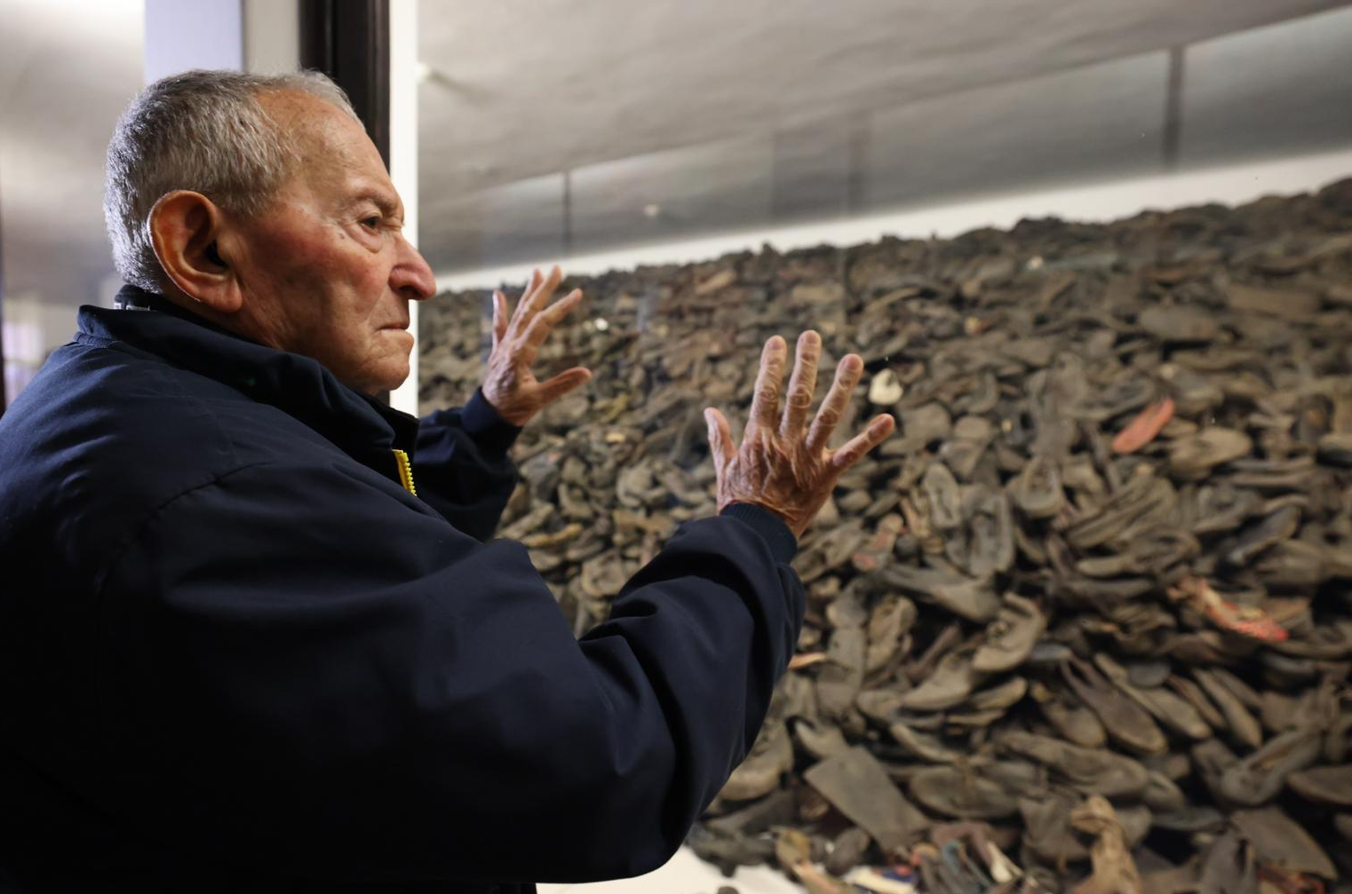
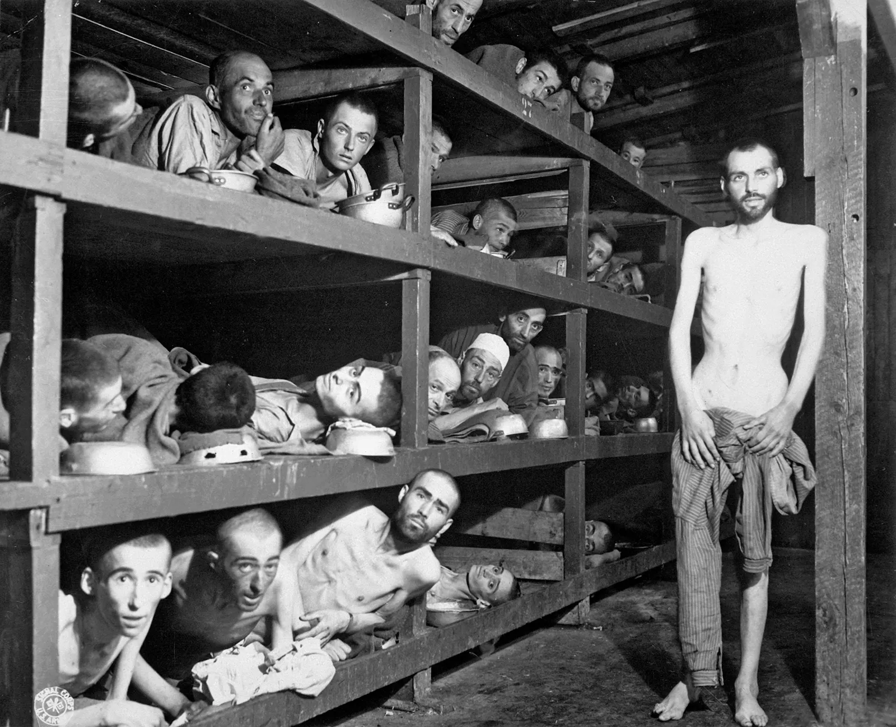
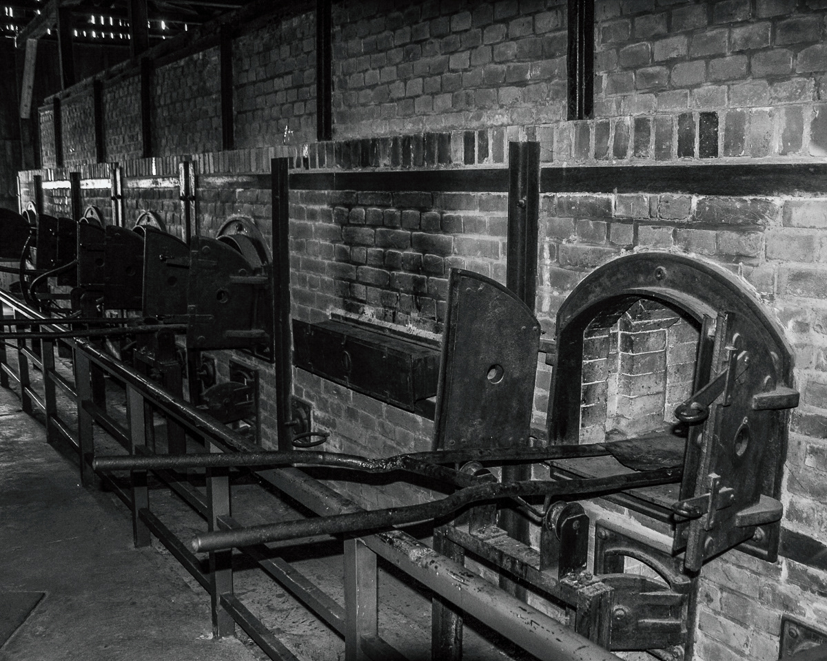
Concentration Camps
Millions die at the death camps. Auschwitz-Birkenau amasses a death rate of 90%, with over 1 million killed at this death camp alone. Others include Bergen-Belsen, Buchenwald, Dachau, Mauthausen, Warsaw, and Kraków-Płaszów.
Top left: Pile of Auschwitz prisoners’ glasses; Top right: Survivor Arie Pinsker looks on at pile of prisoners’ shoes on display at Auschwitz-Birkenau. Bottom left: Auschwitz crematoria into which prisoners were forced to insert and burn the corpses of gassed fellow prisoners, knowing they were next; Bottom middle: Children at Auschwitz showing their prisoner tattoos. Bottom right: Prisoners (including Nobel Laureate Elie Wiesel, circled) at Buchenwald.
8

Slide 28
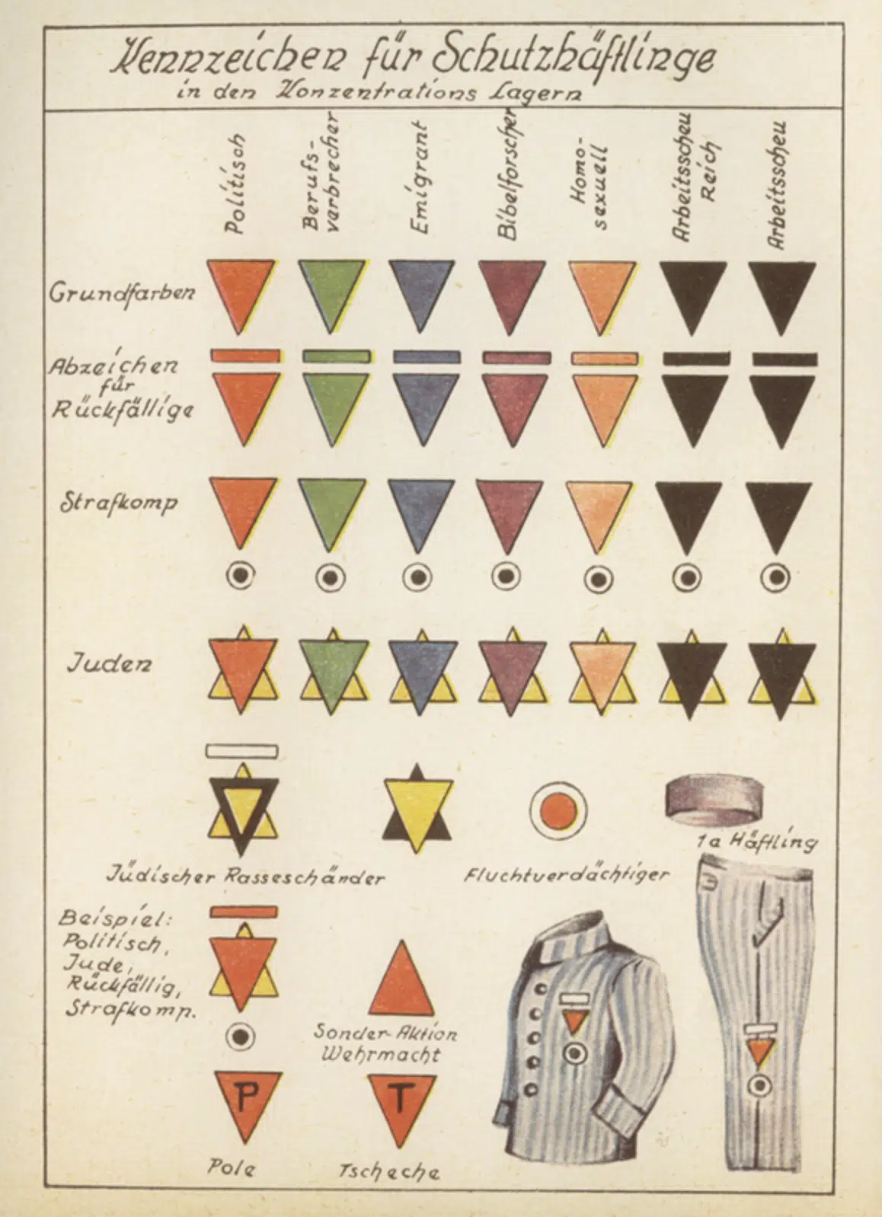
Minorities Persecuted
In addition to Jews, the most-targeted minority, other groups are also heavily persecuted, imprisoned, and killed by the Nazis:
Slavic nations (Soviets, Poles, and Serbs)
Romani people
Jehovah Witnesses
People with intellectual & physical impediments
The LGBTQ community, especially gay men
By 1945, 2 out of every 3 Jews in Europe are dead: The Holocaust kills a total of 6 million Jews.
Badges on prisoners’ uniforms for “cataloging” purposes
9

Slide 29
Content Sources
Britannica Encyclopedia. (2023) The Nazi Empire. Accessed at: https://www.britannica.com/place/Third-Reich/The-Nazi-empire
College of Liberal Arts & Sciences Department of History. (2021). Historians Reflect on International Holocaust Remembrance Day. University of Illinois at Urbana-Champaign. Accessed at: https://history.illinois.edu/news/2021-01-27t222955/historians-reflect-international-holocaust-remembrance-day
Csillag, R. (2014, July 10). “Saved by Wallenberg as an infant, a Toronto artist reclaims her past.” Hamilton Jewish News. Accessed at: https://www.hamiltonjewishnews.com/features/saved-by-wallenberg-as-an-infant-a-toronto-artist-reclaims-her-past
Facing History and Ourselves. (2018). The Rise of the Nazi Party. Accessed at https://www.facinghistory.org/resource-library/rise-nazi-party-0
Felcher, A. (2022). Soviet Dead End: Solving the Wallenberg Mystery in the Cold War. Vera and Donald Blinken Open Society Archives. Accessed at: https://www.osaarchivum.org/blog/soviet-dead-end-solving-the-wallenberg-mystery-in-the-cold-war
Gideon, F. (2013, November 1). To Save the World Entire. United States Holocaust Memorial Museum. Accessed at: https://www.ushmm.org/remember/holocaust-reflections-testimonies/echoes-of-memory/to-save-the-world-entire
Greene, D. (2022, Jan. 26). “Postcards that Bear Witness.” The Newberry Library. Accessed at: https://www.newberry.org/blog/postcards-that-bear-witness
Gutin, A. (2020). The Righteous Among the Nations. Jewish Museum of Maryland. Accessed at: https://jewishmuseummd.org/the-righteous-among-the-nations/
History. (2018). Raoul Wallenberg. A&E Television Networks, LLC. Accessed at: https://www.history.com/topics/holocaust/wallenberg-raoul
Holocaust Memorial Day Trust. (2024). Polish and Slavic Citizens and POWs. Department for Levelling Up, Housing & Communities. Accessed at: https://www.hmd.org.uk/learn-about-the-holocaust-and-genocides/nazi-persecution/non-jewish-poles-and-slavic-pows/
30

Slide 30
Content Sources
Holocaust Museum Houston. (2024). Minority Victims of the Holocaust. Holocaust Museum Houston. Accessed at: https://hmh.org/library/research/minority-victims-guide/
The Holocaust Survivor Memoirs Program. (2014, Mar. 18). “Suddenly The Shadow Fell: First-Hand Accounts from the March 19, 1944 Invasion of Hungary And The Nadir of the Final Solution.” Medium. Accessed at: https://medium.com/@azrielimemoirs/suddenly-the-shadow-fell-4ca42a36e9b1
International Holocaust Remembrance Alliance. (2022). About the IHRA non-legally binding working definition of antisemitism. IHRA. Accessed at: https://www.holocaustremembrance.com/about-us
Jewish Virtual Library. (2024). Death Marches. American-Israeli Cooperative Enterprise. Accessed at: https://www.jewishvirtuallibrary.org/death-marches
The National WWII Museum of New Orleans. (2024). The Holocaust. Accessed at: https://www.nationalww2museum.org/war/articles/holocaust
Raoul Wallenberg Centre for Human Rights. (2023). A Beacon of Light. Accessed at: https://www.raoulwallenbergcentre.org/en/leadership/raoul-wallenberg
Raoul Wallenberg Institute. (2024). About Raoul Wallenberg. The Raoul Wallenberg Institute of Human Rights and Humanitarian Law. Accessed at:
https://rwi.lu.se/about/about-raoul-wallenberg/
Spencer, A. (ca. 2018). “Notes 365 for the small-scale marble sculpture showing Wallenberg at 77…” Accessed at: https://docplayer.net/53538727-Notes-365-for-the-small-scale-marble-sculpture-showing-wallenberg-at-77-created-by-us-artist-hal-goldberg-which-seems-to-be-in-private-property-in-i.html
Tenembaum, B. (2022). Israel. The International Raoul Wallenberg Foundation. Accessed at https://www.raoulwallenberg.net/wallenberg/tributes/world/israel-999/
31

Slide 31
Content Sources
Trudeau, J. (2023, January 17). “Statement by the Prime Minister on Raoul Wallenberg Day.” Government of Canada. Accessed at: https://www.pm.gc.ca/en/news/statements/2023/01/17/statement-prime-minister-trudeau-raoul-wallenberg-day
United States Holocaust Memorial Museum. (n.d). “Raoul Wallenberg Rescues Hungarian Jews.” Accessed at: https://encyclopedia.ushmm.org/content/en/photo/raoul-wallenberg-rescues-hungarian-jews
United States Holocaust Memorial Museum. (2021). Nazi Camps. Accessed at: https://encyclopedia.ushmm.org/content/en/article/nazi-camps
United States Holocaust Memorial Museum. (2021). Remaining Jewish Population of Europe in 1945. https://encyclopedia.ushmm.org/content/en/article/remaining-jewish-population-of-europe-in-1945
United States Holocaust Memorial Museum. (2021). Raoul Wallenberg and the Rescues of Jews in Budapest. Accessed at:
https://encyclopedia.ushmm.org/content/en/article/raoul-wallenberg-and-the-rescue-of-jews-in-budapest
Yad Vashem World Holocaust Remembrance Centre. (2024). Raoul Wallenberg: Sweden. Accessed at: https://www.yadvashem.org/righteous/stories/wallenberg.html
Yad Vashem World Holocaust Remembrance Centre. (2024). Honouring the Righteous. Accessed at: https://www.yadvashem.org/righteous/about-the-program/honoring-the-righteous.html
Yad Vashem World Holocaust Remembrance Centre. (2024). Holocaust Denial Laws and Other Legislation Criminalizing Promotion of Nazism. Accessed at: https://www.yadvashem.org/holocaust/holocaust-antisemitism/holocaust-denial-laws.html
32

Slide 32
Image Sources
Slide 1: Raoul Wallenberg European Union. (n.d.) Searching for Raoul Wallenberg. Raoul Wallenberg. https://www.raoul-wallenberg.eu/
Slide 4: Gilkes, P. (2014, July 15). “Congress awards Raoul Wallenberg medal posthumously July 9.” Coin World. https://www.coinworld.com/news/us-coins/congress-awards-raoul-wallenberg-medal-posthumously-july-9.html
Slide 5, top: Yad Vashem World Holocaust Remembrance Centre. (2024). Raoul Wallenberg: Sweden. https://www.yadvashem.org/righteous/stories/wallenberg.html
Slide 5, middle: Yad Vashem World Holocaust Remembrance Centre. (2024). Raoul Wallenberg: Sweden. https://www.yadvashem.org/righteous/stories/wallenberg.html
Slide 5, bottom: Swedish Institute. (2023). Raoul Wallenberg Saved tens of thousands of Jews from the Holocaust. Sweden.se. https://sweden.se/life/people/raoul-wallenberg-world-war-ii-hero
Slide 6, left: Facing History and Ourselves. (2018). The Rise of the Nazi Party. https://www.facinghistory.org/resource-library/rise-nazi-party-0
Slide 6, middle: Buncombe, A. (2017, April 18). “Allied forces knew about Holocaust two years before discovery of concentration camps, secret documents reveal.” Independent. https://www.independent.co.uk/news/world/world-history/holocaust-allied-forces-knew-before-concentration-camp-discovery-us-uk-soviets-secret-documents-a7688036.html
Slide 6, right: Sydney Jewish Museum. (2011). The Auschwitz Tattoo. Sydney Jewish Museum. https://artsandculture.google.com/story/YAUBUmkOrqfPWA?hl=en
33

Slide 33
Image Sources
Slide 7, top: Glick, M. (2023). Holocaust Exhibit. Mark Glick Photography. https://markglickphotography.com/holocaust-exhibit-1
Slide 7, bottom: Gerry. (2015). Representations of the Holocaust: stage, screen and text. WordPress. https://gerryco23.wordpress.com/2015/04/04/representations-of-the-holocaust-stage-screen-and-text/
Slide 8, top left: Auschwitz-Birkenau State Museum. (n.d.) “Glasses plundered from people deported to Auschwitz.” Auschwitz-Birkenau State Museum Archive. https://artsandculture.google.com/asset/glasses-plundered-from-people-deported-to-auschwitz-auschwitz-birkenau-state-museum-archive/sgFZs6YvxPx3tQ
Slide 8, top right: Wrobel, S. (2022, Sept. 22). “Auschwitz-Birkenau Launches Project to Save Thousands of Holocaust Children’s Shoes From Crumbling.” The Algemeiner. https://www.algemeiner.com/2022/09/22/auschwitz-birkenau-launches-project-to-save-thousands-of-holocaust-childrens-shoes-from-crumbling/
Slide 8, bottom left: Glick, M. (2023). Holocaust Exhibit. Mark Glick Photography. https://markglickphotography.com/holocaust-exhibit-1
Slide 8, bottom right: Digital Public Library of America. (n.d.) “A photograph of Buchenwald inmates on liberation day, April 16, 1945.” Photo. DPLA. https://dp.la/primary-source-sets/elie-wiesel-s-night-and-the-holocaust/sources/1546
Slide 8, bottom middle: Gerry. (2015). Representations of the Holocaust: stage, screen and text. WordPress. https://gerryco23.wordpress.com/2015/04/04/representations-of-the-holocaust-stage-screen-and-text/
Slide 8, bottom left: Glick, M. (2023). Holocaust Exhibit. Mark Glick Photography. https://markglickphotography.com/holocaust-exhibit-1
Slide 8, bottom right: Digital Public Library of America. (n.d.) “A photograph of Buchenwald inmates on liberation day, April 16, 1945.” Photo. DPLA. https://dp.la/primary-source-sets/elie-wiesel-s-night-and-the-holocaust/sources/1546
33

Slide 34
Image Sources
Slide 8, bottom middle: Gerry. (2015). Representations of the Holocaust: stage, screen and text. WordPress. https://gerryco23.wordpress.com/2015/04/04/representations-of-the-holocaust-stage-screen-and-text/
Slide 9: Arnold-Liebster Stiftung. (2022). “Purple Triangles.” Accessed at: https://alst.org/en/history/purple-triangles/
Slide 11: Encyclopedia Britannica. (2024). “Areas under German Control, Nov. 8, 1942.” Photo. https://kids.britannica.com/students/assembly/view/54622
Slide 12: Weiszmann, J. (2023). “The Schutzpass of Judith Weiszmann.” Photo in Tag: Raoul Wallenberg: “Toronto Artist Reclaims Past,” by Singer, Y. Jewish Independent. https://www.jewishindependent.ca/tag/raoul-wallenberg/
Slide 13: Field, R. (2014, July 10). “The Hungarian Holocaust started 70 years ago today.” The Budapest Beacon. https://budapestbeacon.com/the-hungarian-holocaust-started-70-years-ago-today/
Slide 14: Tenembaum, B. (2022). A Guided Visit to Wallenberg’s Budapest. The International Raoul Wallenberg Foundation. https://www.raoulwallenberg.net/wallenberg/tributes/world/israel-999/
Slide 15: The European Holocaust Research Infrastructure Project. (2024). “Death Blows Overhead: The Last Transports from Hungary, November 1944.” EHRI. https://blog.ehri-project.eu/2017/11/23/hungary-1944/
Slide 16: Yad Vashem World Holocaust Remembrance Centre. (2024). Raoul Wallenberg: Sweden. https://www.yadvashem.org/righteous/stories/wallenberg.html
Slide 17: United States Holocaust Memorial Museum. (2021). Raoul Wallenberg and the Rescues of Jews in Budapest. https://encyclopedia.ushmm.org/content/en/article/raoul-wallenberg-and-the-rescue-of-jews-in-budapest
33

Slide 35
Image Sources
Slide 19: Gutin, A. (2020). The Righteous Among the Nations. Jewish Museum of Maryland. https://jewishmuseummd.org/the-righteous-among-the-nations/
Slide 20, left: Analysis Alvarez. (2017). “1996: The Raoul Wallenberg Memorial.” Photo. Ethno-Cultural Monuments in Canada. http://ethnoculturalmonuments.ca/portfolio-items/1996-the-raoul-wallenberg-memorial/
Slide 20, margin (entire): B, L. (2024). “Raoul Wallenberg Park.” Photo. Canada247.info. https://canada247.info/explore/ontario/ottawa_division/ottawa/nepean/raoul-wallenberg-park.html
Slide 21, left: Tenembaum, B. (n.d.). “Monument dedicated to Raoul Wallenberg unveiled in New York.” The International Raoul Wallenberg Foundation. https://www.raoulwallenberg.net/news/monument-dedicated-raoul/
Slide 21, middle: Tenembaum, B. (2022). Israel. The International Raoul Wallenberg Foundation. https://www.raoulwallenberg.net/wallenberg/tributes/world/israel-999/
Slide 21, right: Allen, K. (n.d.) “Raoul Wallenberg Park.” Photo. Read the Plaque. https://read-the-plaque.appspot.com/plaque/raoul-wallenberg-park
Slide 22, left: Farmer, P. (ca. 2013). “Statue of Raoul Wallenberg in Great Cumberland Place.” Photo. Geograph.https://www.geograph.org.uk/photo/3067955
Slide 22, middle: Tenembaum, B. (n.d.) Buenos Aires: Raoul Wallenberg Day in Buenos Aires. The International Raoul Wallenberg Foundation. https://www.raoulwallenberg.net/news/buenos-aires-568/
Slide 22, margin top: Yonina. (2009). “Raoul Wallenberg Street in Jerusalem.” Wikimedia Commons. Photo. https://en.m.wikipedia.org/wiki/File:Raoul_Wallenberg_Street_in_Jerusalem.jpg
33

Slide 36
Image Sources
Slide 22, margin centre: Shutterstock. (2024). “Raoul Wallenberg Memorial Royalty-Free Images: Stockholm, Sweden - July 2019: Raoul Wallenberg Memorial.” Photo. https://www.shutterstock.com/search/raoul-wallenberg-memorial
Slide 22, margin bottom: Blomberg, H. (n.d.) “Raoul Wallenberg Memorial, Linköping, Sweden.” Photos of Memorials. https://sfi.usc.edu/sites/default/files/lessons/units/Photos%20of%20memorials.pdf
Slide 23: The Government of Canada. (2021, Jan. 14). “The Raoul Wallenberg Room.” Post. Canada in Sweden. https://twitter.com/CanadaSweden/status/1349681947224715264
Slide 24: Yad Vashem World Holocaust Remembrance Centre. (2024). Raoul Wallenberg: Sweden. https://www.yadvashem.org/righteous/stories/wallenberg.html
Slide 25, right: United States Holocaust Memorial Museum. (2021). Raoul Wallenberg and the Rescues of Jews in Budapest. https://encyclopedia.ushmm.org/content/en/article/raoul-wallenberg-and-the-rescue-of-jews-in-budapest
Slide 25, left: Gilkes, P. (2014, July 15). “Congress awards Raoul Wallenberg medal posthumously July 9.” Coin World. https://www.coinworld.com/news/us-coins/congress-awards-raoul-wallenberg-medal-posthumously-july-9.html
Slide 40: UNC School of Medicine. (2021). “Commemorating MLK, Jr., Remembering the Holocaust, and Celebrating Black History Month.” The University of North Carolina at Chapel Hill. https://www.med.unc.edu/medicine/news/commemorating-mlk-remembering-holocaust-celebrating-black-history-month/
33

Slide 37
Video Sources
Riddle Films. (2016). “Raoul Wallenberg: If You Save One Life, You Save the Whole World” Video. YouTube. https://www.youtube.com/watch?v=m4KytJNxGAE
USC Shoah Foundation. (2022). “The Arrival of Raoul Wallenberg. | Agnes Adachi’s | USC Shoah Foundation.” Video. YouTube. https://www.youtube.com/watch?v=1zUY2jCjURo
World Jewish Congress. (2020). “The Bravery of Swedish Diplomat Raoul Wallenberg.” Video. YouTube.
https://www.youtube.com/watch?v=kapaF4yzHw0
Yad Vashem. (2010). “Saved by RIghteous Among the Nations Raoul Wallenberg in Budapest: Vera Goodkin’s Testimony.” Video. YouTube. https://www.youtube.com/watch?v=2fGGaWOxwRk
﻿Yad Vashem. (2022). “The Story of Raoul Wallenberg: Righteous Among the Nations.” Video. YouTube. https://www.youtube.com/watch?v=zHg1BU12vwk
34

