Slide 1

Curriculum to Classroom: Teaching the Holocaust in the new Grade 10 curriculum
Notes:
Introduce all of us and mention how CHES was part of the re-write and improvement of this part of the curriculum, with several other orgs. Very responsive. And this ppt is on our website, with all the hyperlinks and resources for you to access at any time.

Slide 2
Purpose of Today
A practical teaching structure
A chronological way to organize learning
Ready-to-use lesson ideas
Focus on classroom delivery
Notes:
We’re all teachers and we want to make this a worthwhile hour for you so our goals are:

Slide 3
Teaching Challenge
Complex and emotionally heavy content
Students come with uneven prior knowledge
Current world events can shape student reactions
Risk of over-simplification or overload
Notes:
To start: teaching the Holocaust is and has always been a challenging topic for a variety of reasons you can see here, and I am sure you have more of your own and we can discuss these are we go and/or leave those to discuss at the end, just clarifying that this is not an easy topic to teach or to learn.

Slide 4

New Expectations
C1.6
identify some extreme political/social ideologies in the world during this period and assess their significance and impact on democracy and on different individuals, groups, and communities in Canada and around the world
Political ideologies:
fascism, totalitarianism, authoritarianism, ultranationalism, racial nationalism, imperialism, Stalinism, communism, Nazism
Social ideologies:
racism, ethnocentrism, antisemitism, eugenics, social engineering, Aryan race supremacy
Notes:
We will not bore you and read you the new curriculum but to summarize grade 10 history teachers are responsible for teaching more of the Holocaust, from the coming to power of Hitler in 1933 to the post war, from how it was carried out to the global reaction before, during and after it ended.

Slide 5
More expectations
C2.6
analyze the impact of Nazism and the Holocaust on Jewish communities in Europe, and some significant ways in which the Canadian government and some individuals and groups in Canada responded to this and assess some of the impacts that antisemitism has had and continues to have on Jewish communities in Canada
C3.3
analyse the impact of the Holocaust on Canadian society and on the attitudes of people in Canada towards human rights )
Notes:
So this does add a lot in terms of what needs to be taught. And our goal today is not to overwhelm you but to give you practical advice, ideas and resources so that you can either further develop your unit or begin to develop one, if you are new to teaching this topic. With that in mind:

Slide 6
Take two minutes to choose and do one:
If you already teach The Holocaust, what do you find most challenging about this unit?
OR
If you have not yet taught this topic, what are you most concerned about?
Notes:
Take answers but don’t waste time here

Slide 7
Main Idea:
👉 Teach the Holocaust as a process over time, not a single event
Ensure students understand it developed over years
It did not start with death camps and mass murder
Do not let them oversimplify
11 Excellent Tips for how to do this well:
https://museeholocauste.ca/en/resources-training/teaching-holocaust-middle-high-school/
https://www.vhec.org/how-to-teach-the-holocaust/
Notes:
So let’s move into some ideas on how to teach this unit. I won’t read what is on these slides, but one main point we want to stress is to ensure that you are teaching the Holocaust as a process, one that unfolded over a number of years in a number of countries. In order to help I have linked two excellent lists of dos and don’ts, one from the Mtl museum and one from Vancouver. Go into one. These are for you as teachers, not your students to give you a sense of what does work and what might not be as effective.

Slide 8

How to Start: Films, Vocabulary, Timelines, Life before the Holocaust
Film: The Path to Nazi Genocide (USHMM)
https://www.youtube.com/watch?v=dDuHWVv4ac0
John Green’s Crash Course:
https://www.youtube.com/watch?v=iQeDvnapdlg
Here is a film for teachers for background:
https://www.youtube.com/watch?v=1f_xs9UGoR8
Notes:
So how do you start: there are many ways: here are some that we have all used. You can start with a film, the third one here is again better for teacher background, but the first two iare excellent for students at this level. The first is brief (38 mins) and does an overview from the end of WWI all the way through the rise of the Nazis and the 30s to the outright mass murder. The second is John Green at his best, shorter (14) and more philosophical in a way. There are many others on line, I suggest these as a way to start.

Slide 9
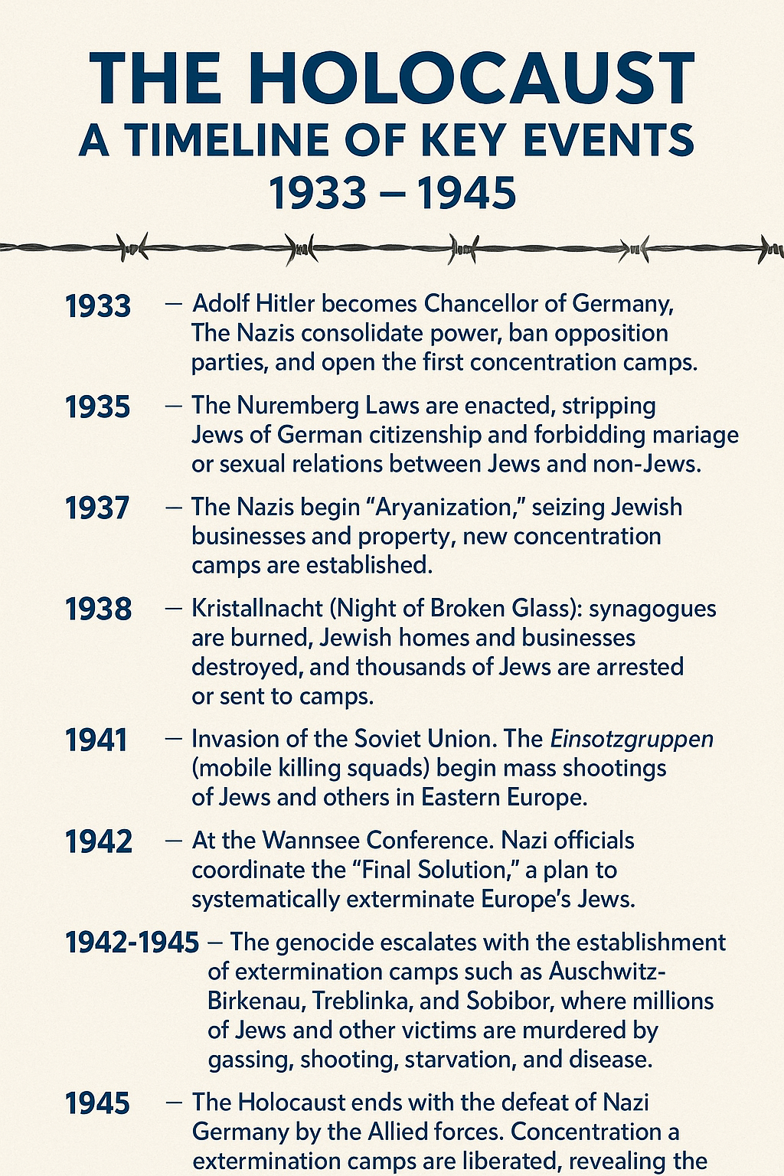
Timeline:
Notes:
In addition to a film often an overview through a timeline is a strong way for students to see that it was incremental and to stop and discuss why that might have been. There is a lot to point out and discuss in each of these sections.

Slide 10
Vocabulary
Holocaust
Genocide
Antisemitism
Nazi Party/Hitler
Nuremberg Laws
Propaganda
Persecution/discrimination/stereotyping
Ghetto
Concentration Camp
Notes:
Another way to start or to add to one of the other ways is through vocabulary: in groups, think pair share, assigning key words to different students, etc. And we have put together a long list of words that they will come across in this unit.

Slide 11
More Vocabulary
Death Camp
The Final Solution
Holocaust by Bullets
Death March
Displaced Persons
Nuremberg Laws
Holocaust Denial/Distortion

Slide 12
OR
Start with life before persecution
Jewish life in Europe before 1933
Culture, family, community
Normalcy before disruption
Notes:
Another way to go is through individuals. Or I have done this after doing a mix of the other ways.

Slide 13
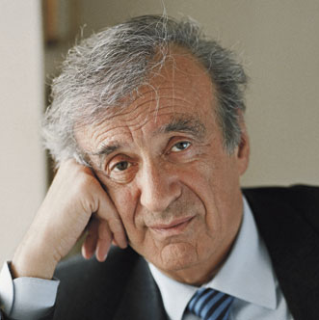
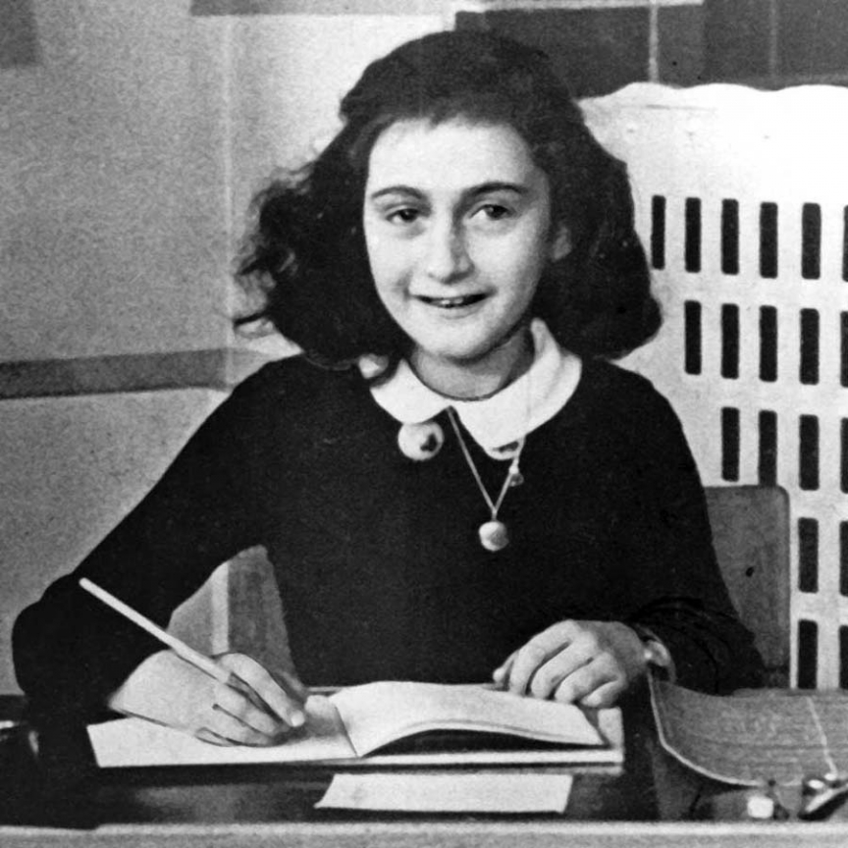
Famous Lives
Elie Wiesel
“My childhood was really a childhood blessed with love and hope and faith and prayer.
“My ambition really was, even as a child, to be a writer, a commentator, and a teacher, but a teacher of Talmud.”
Anne Frank
“All I think about when I'm with friends is having a good time.”
This Photo by Unknown Author is licensed under CC BY
This Photo by Unknown Author is licensed under CC BY-NC-ND
Notes:
You can start with famous lives, and these are a few quotes I’ve taken from their work, and you can see there is a sense of normalcy in what life was like before. I had another quote where Anne is complaining about how adults ignore their children’s opinions. All very normal. It adds a personal touch, especially referring to Holocaust victims who were children. Anne Frank and Elie Wiesel were both 15 when they were arrested and deported, the age your students are as they learn this.

Slide 14
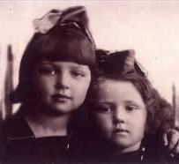
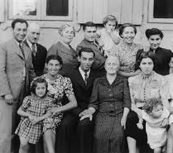
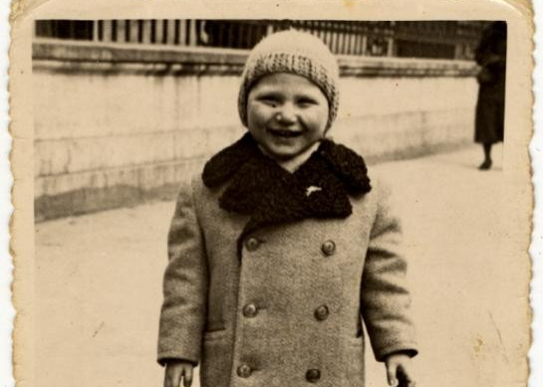
Not famous
From the USHMM and Yad Vashem
For a Canadian perspective:
https://max.liberation75.org/?i=1
(Max Eisen)
https://sydneyjewishmuseum.com.au/wp-content/uploads/2025/11/Worksheet-Jewish-Life-1.pdf
Notes:
Normalcy, ppl over numbers, victims rather than Hitler, the change from living normally to being subjected to laws and then violence and then death. They can search a site and find one pic and what happens to that person. The last one is from the Sydney Jewish museum on life before the war.

Slide 15
Stages of the Holocaust
Prejudice
Legal exclusion
Social isolation
Violence
Systematic persecution
Concentration (ghettos and camps)
Murder (The Final Solution)
Notes:
1And after you launch the unit you need to go through the stages of the Holocaust. Again you can refer to your timeline here. I like to break it into stages, 1933-39, 1939-41, 1941-45. I stress often that the nazis did not come to power and immediately start to murder people. What did it look like, how was Germany transformed, how did people react? Etc. All good questions for greater critical thinking.

Slide 16
Examples of laws
https://encyclopedia.ushmm.org/content/en/article/anti-jewish-legislation-in-prewar-germany
https://www.ushmm.org/m/pdfs/20180228_3_Laws_and_Decrees_Timeline.pptx.pdf
Examples of legislation from pre-war Germany with primary documents and questions.
Stress that this was a gradual process.
Notes:
Here I have often used a ppt on the actual laws the Nazis enacted, it shows students how life was changed in small and big ways for all of Germany’s Jews long before the war began and it helps explain why Jews were desperate to leave, which will factor in again later.

Slide 17
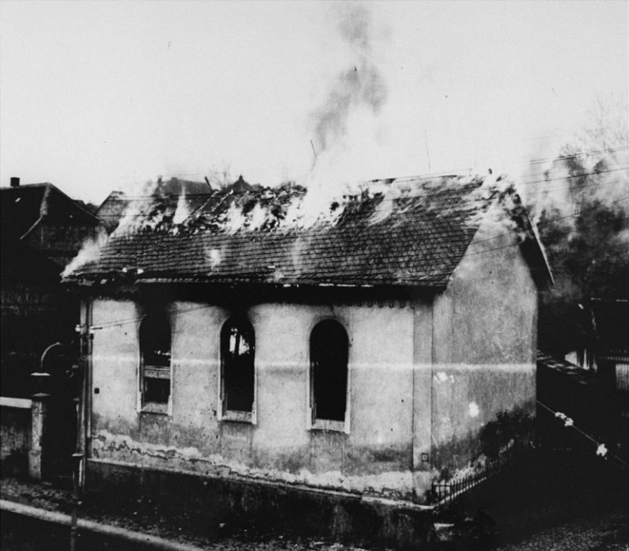

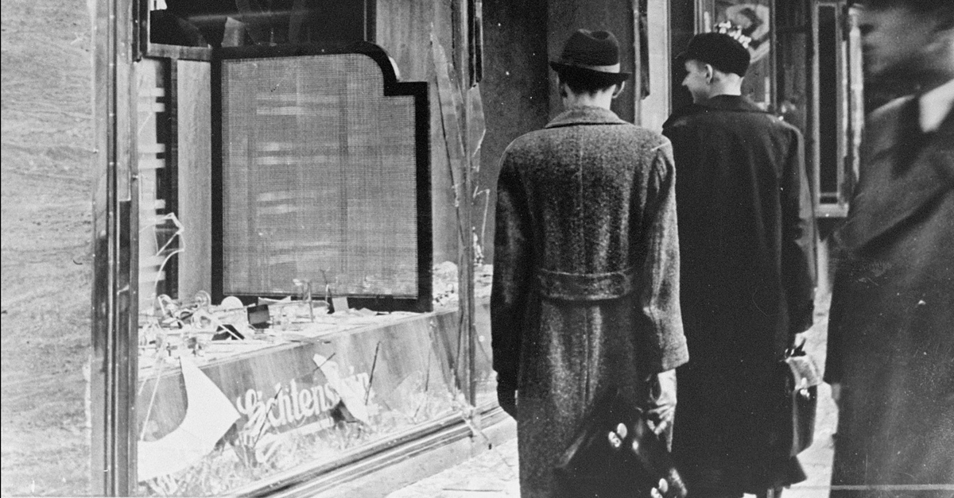
Violence: Kristallnacht or November Pogroms
This Photo by Unknown Author is licensed under CC BY-SA
This Photo by Unknown Author is licensed under CC BY-SA-NC
This Photo by Unknown Author is licensed under CC BY-ND
A LP from the Sydney museum:
https://sydneyjewishmuseum.com.au/shop/teacher-resources/the-november-pogrom-kristallnacht/
Notes:
Turning point, this makes it obvious when the Nazis use violence on a broad scale against Jews in G and Austria (which they have taken over by then.) And an excellent ready to use LP from the Sydney Jewish museum.

Slide 18
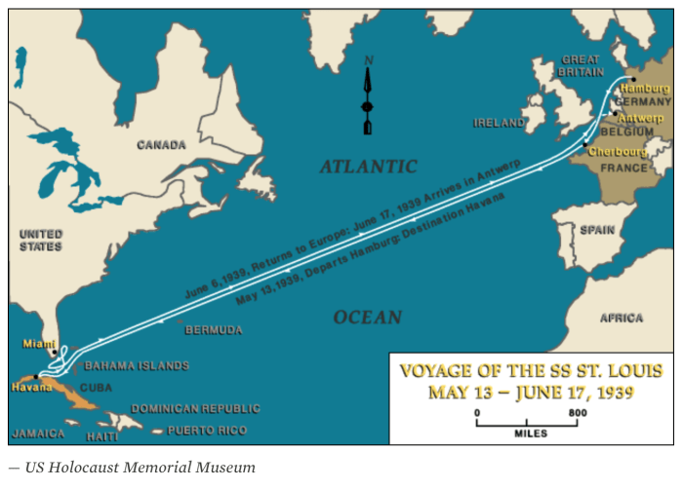
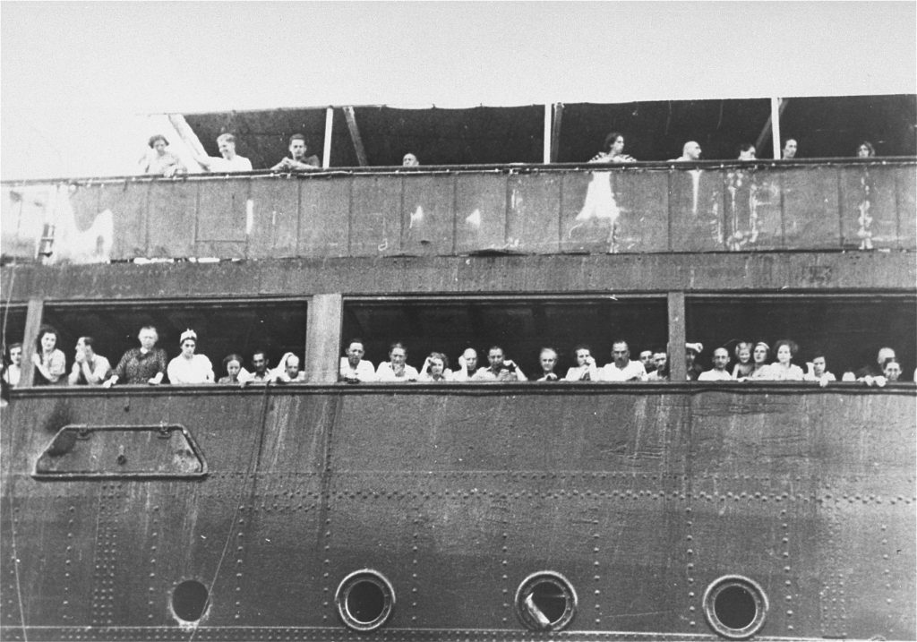
Global Reaction
Link Canada here (“None is Too Many”):
Lesson Plan on antisemitism in Canada and our reaction to Nazi Germany
https://torontoholocaustmuseum.org/learn/unpacking-canadian-antisemitism-for-high-school-students
https://vhec.org/wp-content/uploads/TCTH-Teachers-Guide.pdf
(With Paul’s questions)
This Photo by Unknown Author is licensed under CC BY-SA-NC
This Photo by Unknown Author is licensed under CC BY-SA
Notes:
After this pogrom there is discomfort in the world and they had choices to make. This is a good time to bring in Canada and show how Canada they chose not to act, excellent place to stop and link to Canada. There is a lesson plan here that discusses the Evian Conference and the M.S. St. Louis and Can’s abysmal record and the antisemitism across the population and the highest levels of gov. The one on Vancouver even links the treatment of the Jews to our treatment of the Syrian refugees ten years ago.

Slide 19
Escalation to Mass Violence
A “war within a war”
Ghettos
Deportation
Camps
Mass Murder
Resistance
How to teach this:
Notes:
Then you move into the war and what most people associate with the Holocaust, from the ghettoization and slow death of the Jews mainly but not exclusively in EE to the deport…… How to cover this:
Some things that have worked with us: mini presentations, posters, short animated films, key people i.e. Wallenberg, Shindler. Do not show whole movies unless you have tons of time

Slide 20
Some ways to teach these:
Mini group presentations
Posters
Speakers
Primary documents
Artefacts (All resources at the end have a section with artefacts)
Short films/animated films (next slide)
Example:
Resistance:
Wallenberg (LP on CHES site)
Clips from Defiance, Sabotage
Notes:
Again there are lesson plans in all the resources at the end.

Slide 21
Personalize this:
Link back to: Anne Frank, Elie Wiesel, Max Eisen, etc: their books, biographies, interviews
Or: One Survivor Remembers (Gerda Weissman)
https://www.youtube.com/watch?v=TQuKt71B-48
Another Canadian link: Sabotage
Notes:
Do not overwhelm them or concentrate on numbers exclusively. Yes, the sheer scope of the numbers must be taught but take the time to look at individuals. My students always said this made it more real to them. That’s why speakers and 2nd gen are so important. And the film above is outstanding for this.

Slide 22
Liberation
Band of Brothers clip on liberation:
https://www.youtube.com/watch?v=VOXUYAskOWY
Canada Link: writings/radio broadcast of Georges Vanier
https://www.vhec.org/images/pdfs/CRH_ExhibitSupplementScrapbook.pdf
This did not end neatly
What happened to the survivors?
How do you live after this?
How does the world react?
Lesson Plan on Ted’s Story (CHES website)

Slide 23
Resources
USHMM https://www.ushmm.org/
Yad Vashem https://www.yadvashem.org/
Toronto Holocaust Museum https://torontoholocaustmuseum.org/
Montreal Holocaust Museum https://museeholocauste.ca/en/
CHES https://chesatottawa.ca/
Liberation 75 https://www.liberation75.org/
Vancouver Holocaust Education Centre https://www.vhec.org/

Slide 24
Questions:
Notes:
Their questions

Slide 25
Potential discussion points:
Why do we teach it?
How should we teach it?
How do we memorialize it?
How do we go forward with so few and soon no survivors?
What are our concerns going forward?
Notes:
Some if they have none

